Slide 1

Title: Financial Forecasting Dashboard using Power BI
Team Name : Power Titans
Sagar K A
Aman Arora
Nimisha Rajendra
Sahana S
FINANCIAL FORECASTING DASHBOARD PROJECT

Slide 2

TABLE OF CONTENTS
1
Project Statement
11
Conclusion
2
Introduction to PowerBI
3
Financial Forecasting
1
4
About dataset
13
5
Project Objective
14
6
Dax formulas
7
Step To demonstrate Project
8
Visualizations
9
Future Enhancements
10
Milestone

Slide 3

PROJECT STATMENT
Forecasting is a prediction with the same level of granularity as the data point used. After importing the dataset, temporal analysis via the built-in option involves using a line chart because it is essential to have a continuous temporal reference on the x-axis. On the y-axis, you will insert the aggregated measure, relative to the data point’s granularity level, for which we want to calculate the forecast.

Slide 4
INTRODUCTION
Definition: Power BI is a Business Intelligence tool used to clean the data, analyze the data and convert the data into visual format.
Overview of Power BI :
A Microsoft tool for visualizing data and sharing insights.
Offers interactive dashboards and easy data transformation.
Significance in Financial Visualization :
Tracks KPIs, identifies trends, and drives decisions.
Scope of the Project:
Create a Financial dashboard to analyze trends, monitor revenue, and evaluate performance.
Provide actionable insights to optimize strategies.

Slide 5
Financial Forecasting
Financial forecasting is the process of estimating or predicting a company's future financial outcomes based on historical data, trends, and assumptions.
Using Power BI for financial forecasting, the process includes:
Importing Historical Data: Bringing in data that contains past financial performance.
Temporal Analysis: Applying a time-based analysis, often using a line chart where the time dimension (e.g., months) is displayed on the x-axis. This time series allows for continuous visualization of data trends over time.
Aggregated Measures: Plotting measures such as revenue or profit on the y-axis, which can then be forecasted to predict future values based on historical patterns.
.

Slide 6

ABOUT THE DATASET
Key Attributes and Structure :
Attributes:
Product Details: Product Name, Discount Band, Manufacturing Price, Segment, Country.
Sales Information: Sale, Units sold, Gross Sales, Sale price, COGS, Discounts, Profit.
Time Details: Date(date, month and year).
Purpose of Selecting This Dataset :
To create a comprehensive financial dashboard that visualizes:
Sales and profit trends over time.
Performance metrics like revenue, profit, and product-wise analysis.
Return trends and their impact on profitability.

Slide 7
PROJECT PLAN & OBJECTIVES
Goals of the Dashboard Project:
Track sales performance across countries, time periods, and product categories.
Monitor the impact of product returns on profitability.
Provide actionable insights for stakeholders to optimize strategies.
Key Insights Addressed :
Revenue & Profit: Identifies top-performing product and segments.
Discounts : Analyzes their impact on profitability.
Product Performance: Highlights best and worst-performing products.
Financial Trends: Shows Financial trends across different time periods.
Workflow :
Data Preparation: Cleaned and merged data , Apply Dax formulas.
Visualization: Created charts with slicers.
Analysis: Calculated KPIs and trends.

Slide 8
APPLYING DAX FORMULAS
Key DAX Formulas Used:
Total Profit : To calculate overall profit
TotalProfit = SUM(financials[Profit])
2.Total Revenue: Summed up sales figures to track overall performance.
TotalRevenue = SUM(financials[ Sales])
3. Profit Margin: To know about profit margin
ProfitMargin = DIVIDE([Total Profit],[TotalRevenue], 0)
4. Forecasted Revenue: To calculate overall forecasted revenue by considering 10%
ForecastedRevenue = [TotalRevenue] * 1.10

Slide 9
Step to Demonstrate project
Creating a financial forecasting dashboard in Power BI involves several steps, from importing data to building visualizations
Step 1: Import Data
Step 2: Transform Data (Data Cleaning and Preparation)
Step 3: Define Data Model and Relationships
Step 4: Create Visualizations for Temporal Analysis
Step 5: Add Additional Visualizations for Insight
Step 6: Build the Dashboard
Step 7: Publish and Share the Dashboard
Step 8: Review and Refine

Slide 10

ANALYSIS

Slide 11
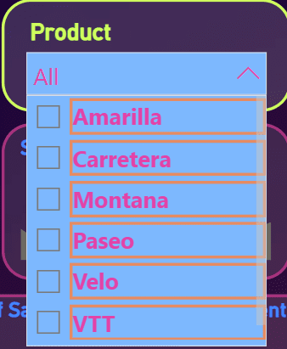
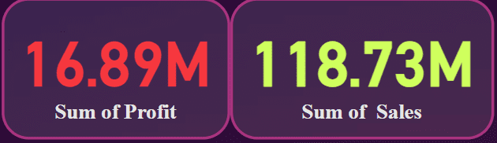
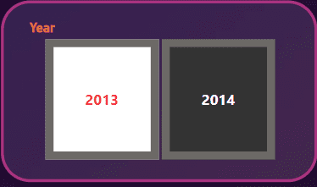
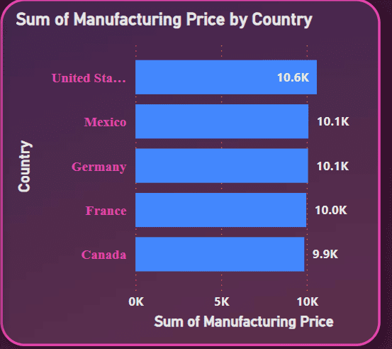
Product Analysis
Details: Analyzes sales of each product
Use: Due to use of slicer selecting of each product show individual performance
DASHBOARD OVERVIEW
Sum of Sales and profit
Details: Highlights the average sales (118.73M) and average profit (16.89M).
Time analysis:
Details: using slicer to create time series analysis.
Manufacturing Price:
Details: Shows the increase in sales from 2013 to 2014.
Use: Helps track yearly sales performance and identify growth trends.

Slide 12
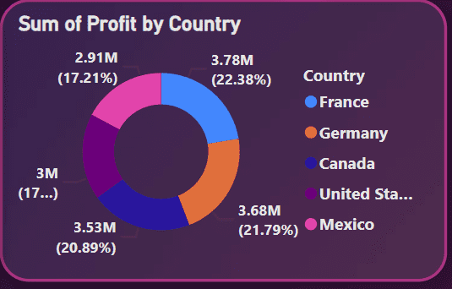
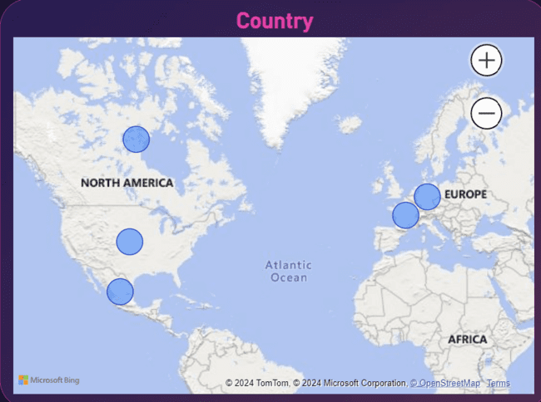
DASHBOARD OVERVIEW
Profit of each country :
Details: France has more profit than other countries
Regional Sales Analysis:
Details :Shows sales performance across countries.
Use: Focuses on improving underperforming areas.

Slide 13
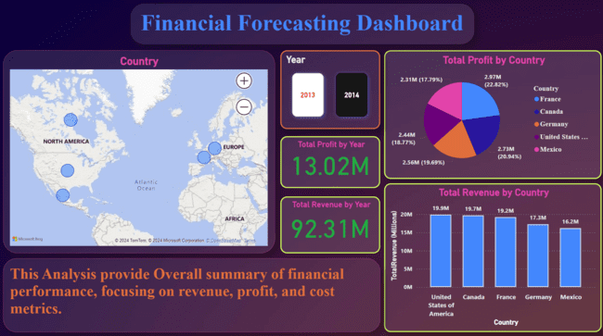
DASHBOARD OVERVIEW
Fig: Overview of Financial Dashboard

Slide 14


OBSERVATION
The analysis shows manufacturing prices of each product. In 2014 due to higher Sales demand the manufacturing price is increased up to 10.6K, while in 2013 it was only 3.7K. best-selling it tells manufacturing price is increased drastically over the year.
The analysis reveals Strong sales of each product in segments, across countries. This helps to know most sold product is Paseo with value of 33.01M with respect to Total sales. At the top we have product slicer which helps to track each product individually.
The analysis shows a strong overall profit gained by products in each countries and government segment profit is more dominating. Profit peaked towards the end of the year, indicating potential growth.
Paseo is the best-selling product.
USA is the top profiting Country.
Total profit margin is 14.23%.
Approx revenue is 128M.

Slide 15
FUTURE ENHANCEMENTS
Predictive Analytics Integration: Incorporate machine learning models to predict future sales trends and customer behavior.
Advanced Segmentation: Use clustering techniques to identify more granular segments.
Real-time Data Updates: Enable real-time data processing for live dashboards.
Geospatial Analysis: Add geospatial maps to visualize regional sales performance and trends dynamically.
Custom Alerts: Develop notifications for anomalies in sales, returns, or profit metrics.

Slide 16
MILESTONES
Milestone 1: Data Preparation Preparation
Milestone 2: Create time series visualization
Milestone 3: Implementing Forecasting Models
Milestone 4: Finalizing the Financial Forecasting Dashboard

Slide 17

CONCLUSION
The Sales Performance Dashboard provides a comprehensive view of sales trends, customer behavior, and product performance.
It enables data-driven decisions to optimize strategies and enhance profitability.
By analyzing key metrics like profit margins, return patterns, and regional sales, businesses can streamline operations, improve customer satisfaction, and maximize revenue.
This project highlights the potential of visual analytics tools like Power BI to transform raw data into valuable insights.

Slide 18

THANK
YOU!

